Slide 1

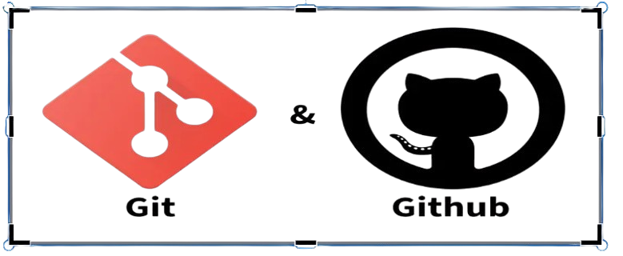
Recitation 0.7
Git/Github
TA: Malihah & Khushee

Slide 2
Git
Git is a Version Control System.
It is like a time machine + teamwork tool for code.
Why Git?
You Never Lose Your Work
Easy Teamwork
Safe Experimenting (Branches)
Fast and Efficient

Slide 3
Version Control System (VCS)
A VCS is software that tracks and manages changes to files
over time, enabling collaboration and rollback.
Tracks changes to files
Maintains version history
Supports team collaboration
Enables rollback to older versions
Records who changed what

Slide 4
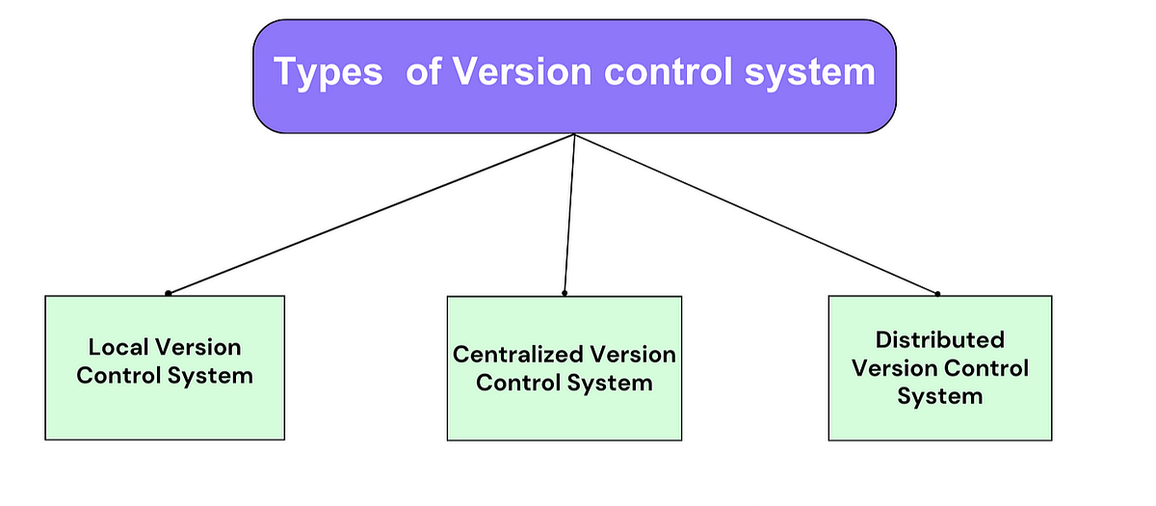
vcs

Slide 5
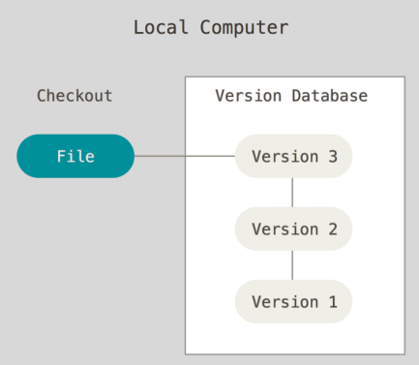
Local VCS
A Local VCS stores all file versions and
history on a single computer.
It tracks changes by saving snapshots in
a version database and allows users
to checkout versions for editing.
It works offline, supports solo development,
and has no built-in collaboration features.

Slide 6
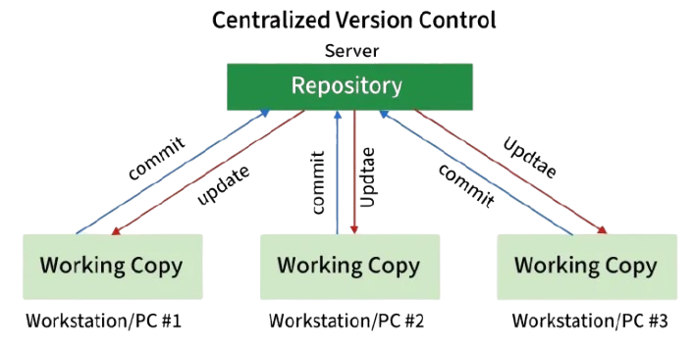
Centralized VCS
A Centralized VCS stores all project versions on
a central server, where users commit and
update changes, requiring network
access for collaboration.
One central server stores the complete
project history.

Slide 7
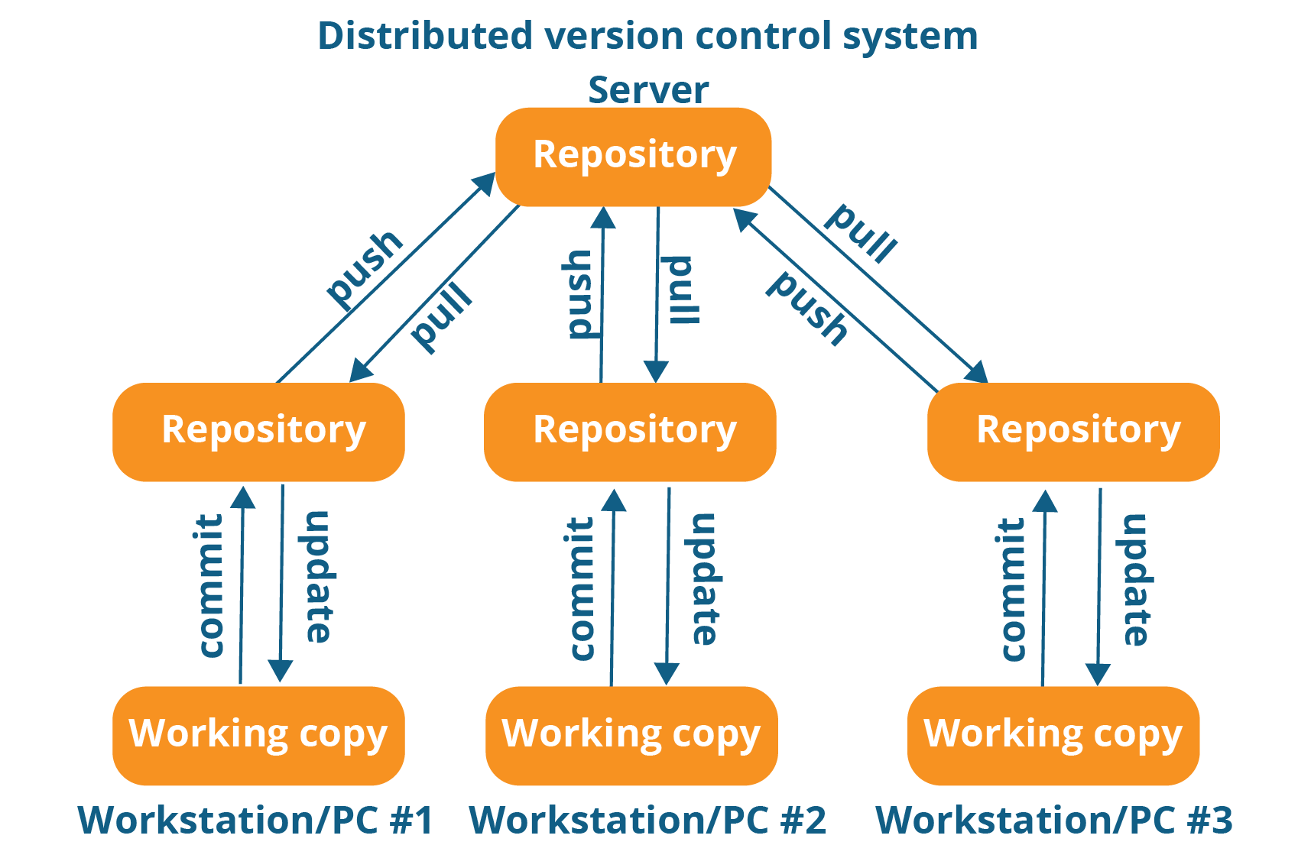
Distributed VCS
A Distributed VCS is a system where
every user has a full local copy of the repository,
enabling offline commits, branching,
merging, and secure collaboration.

Slide 8
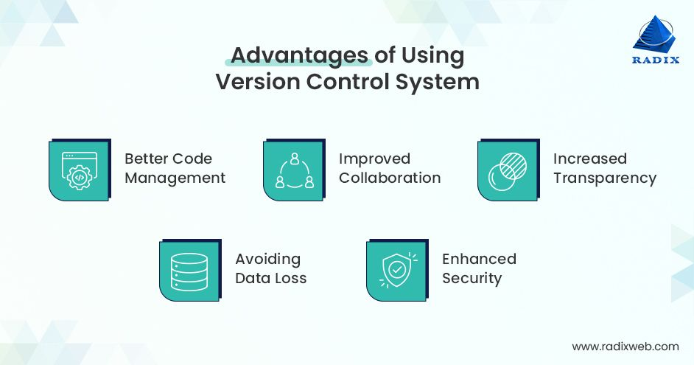

Slide 9
Github
GitHub is an online platform that hosts Git repositories, enabling
developers to store, share and manage their codes using Git. GitHub is like Google Drive for code, but with built-in version control, collaboration, and development tools.
https://github.com

Slide 10
Setting up Git
Visual Studio Code
Windows (Git Bash)
Mac (Terminal)
git --version

Slide 11
Configuring Git
git config --global user.name “Khushee”
git config --global user.email “khushee@gmail.com”
git config --list

Slide 12
Github Account
Create a new repository : github-demo
Make our first commit

Slide 13
Clone & Status
Clone- Cloning a repository on our local machine
git clone <- some link ->
status- displays the status of the code
git status

Slide 14
Add & Commit
add- adds new or changed files in your working directory to the Git staging area.
git add <- file name ->
commit- it is the record of change
git commit -m “some message”

Slide 15
Push Command
Push- upload local repo content to remote repo
git push origin main

Slide 16
Init Command
git init
git remote add origin <-link->
git remote -v
git branch
git branch -M main
git push origin main

Slide 17
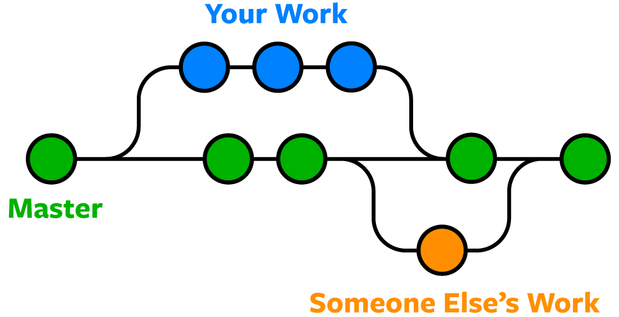
Git Branches

Slide 18
Branch Command
git branch (to check branch)
git branch - M main (to rename branch)
git checkout <-branch name-> (to navigate)
git checkout -b <-new branch name-> (to create new branch)
git branch -d <- branch name-> (to delete branch)

Slide 19
Merging Code
Way 1
git diff <-branch name-> (to compare commits, branches, files & more)
git merge <-branch name-> (to merge 2 branches)
Way 2
Create a PR

